Slide 1
Gaining Approval of Solid Waste Regulatory Submittals: Lessons Learned in a 35-Year Career
WSWRA Annual Conference
August 18, 2021
Notes:
Dan

Slide 2
Introduction
Brad Coleman, PE
Account/Program/Project Manager
BS Geological Engineering, SDSM&T, 1985
Professional Engineer in 5 states
Colorado SWANA board member & Past President (2018-19)
35+ years in solid and hazardous waste (10 years in Wyoming)
Specializes in planning, designing, permitting, operating, remediating, and closing solid and hazardous waste facilities

Slide 3
The Gamut of Needed Solid Waste Approvals
Permit Applications
Greenfield facilities
Renewals/lifetime permits
Major/minor modifications
Title V air permitting
Compost and Recycling Facilities
Transfer Stations
Remediation/Redevelopment
NES
ACM
Brownfields
CCR
Design & Construction
Permit-level
Issued For Construction
CQA Certification Reports
Operations/Maint. Plans
Monitoring Plans
Closure Plans
Financial assurance
Post-Closure Care
Special Waste
HHW
Asbestos
PCS
Others

Slide 4
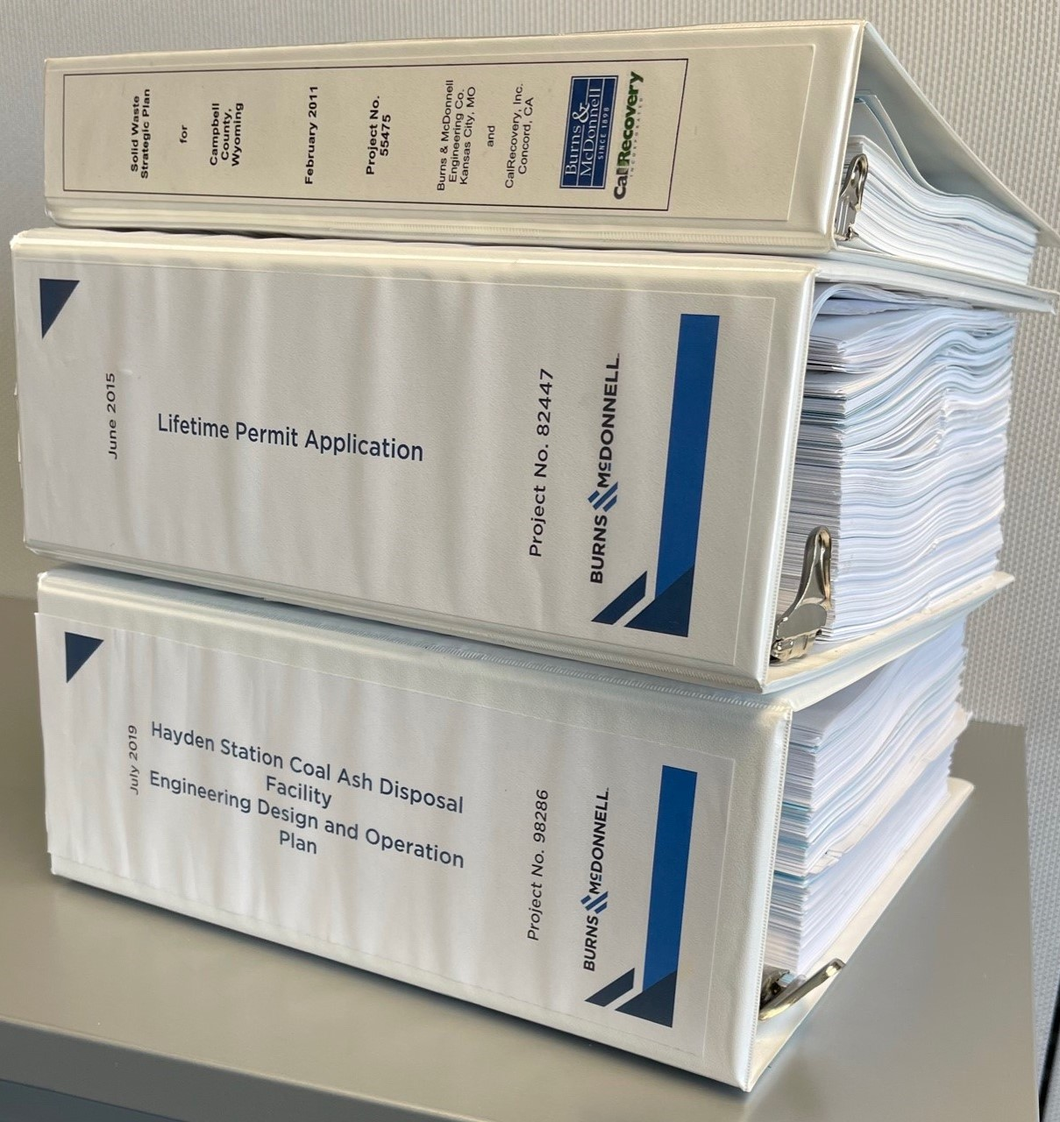
Potential Perils
Non-Compliance
Negative Publicity
Cost Uncertainty
Schedule Uncertainty
Fines
Public Opposition
Shutdown
Notes:
BradIn

Slide 5
MISSION STATEMENT
Make Our Clients Successful

Slide 6
My Approach
Understand your client’s needs
Understand the regulations
Develop a permitting strategy
Meet w/ your regulators
larger projects
Provide quality/easily navigable submittals
Provide interim submittals/solicit feedback
Meet regularly and have an agenda
Revise approach & implement
APPROVAL!
Resolve comments
Revise and Resubmit
Repeat as necessary
Notes:
Need to tie this to the County’s needs, particularly their landfill expansion

Slide 7
Key Principles (Part 1)
Know your regulations
Don’t expect your regulator to teach you
Get the right expertise
BS gets you no where, credibility is critical
Relationships matter
Keep things positive - always
Discuss all key components
Communicate, communicate, communicate
Notes:
Brad

Slide 8
Key Things to Remember (Part 2)
Own your mistakes
Recognize, learn, move on
Stick to the technical/regulatory issues
Don’t take/make things personal
Recognize other points of view
Listen, consider, compromise
Stay organized and looking ahead
Know your critical path
Notes:
Brad

Slide 9
Key Things to Remember (Part 3)
Emphasize quality control & standardization
Quality and consistency are key to credibility
Don’t frustrate your reviewer
Don’t underestimate good bookmarks
Be responsive!
Get buy-in on responses and incorporate them
Pick your battles
Most fights just aren’t worth it – but some are
Notes:
Brad

Slide 10
Make Your Client Successful!

Slide 11
Q&A

