Slide 1
Grant Funding Opportunities
Wyoming Solid Waste and Recycling Association 2022 Conference
August 2022
Powell, WY
Vincent Leray, Grant Development Manager
Notes:
Intro that I’ll be talking about

Slide 2
Agenda
Intro to The Recycling Partnership
Processors
Curbside
State and Regional
Drop-off
Discussion
Notes:
Be honest about intentions – why our funders give to us / why I am presenting in Wyoming.
Funders want packaging in the circular economy // I want grants to communities

Slide 3

Vincent Leray
he/him
Grant Development Manager
vleray@recyclingpartnership.org
662.640.8571

Slide 4

  Healthy Recycling Needs a Systems Approach

Slide 5
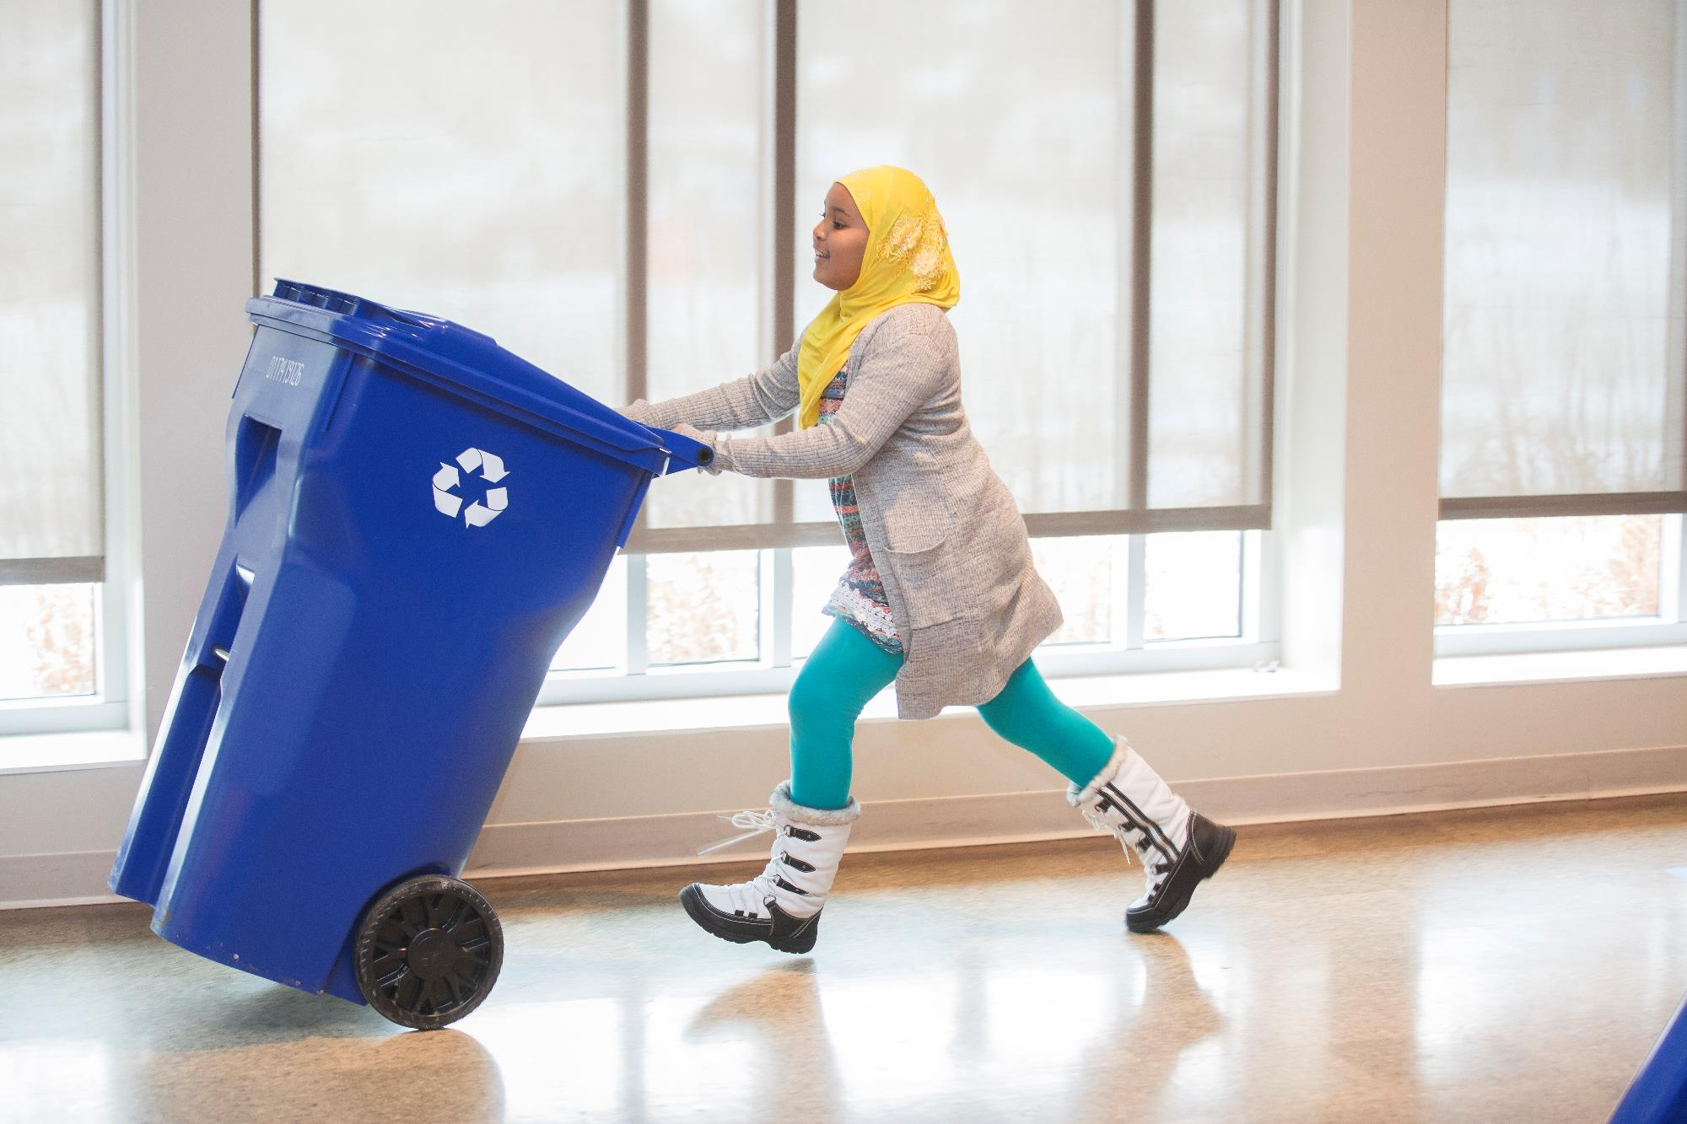
We’ve reached 60% of the U.S. population.
Our proven recycling system solutions increases access and improves quality.
Notes:
Our goal. Make it as easy for all Americans to recycle something properly as it is to throw it away.
What does that mean? We put private dollars to work in communities by investing in infrastructure like recycling carts and recycling trucks. We empower strong peer-to-peer networks to share and learn from each other to drive change. We conduct research to understand the challenges in the current system and help develop technical solutions. And, we provide proven residential education to make recycling systems run better, decrease contamination and increase participation – making it easier for residents to recycle more and recycle better.

Slide 6
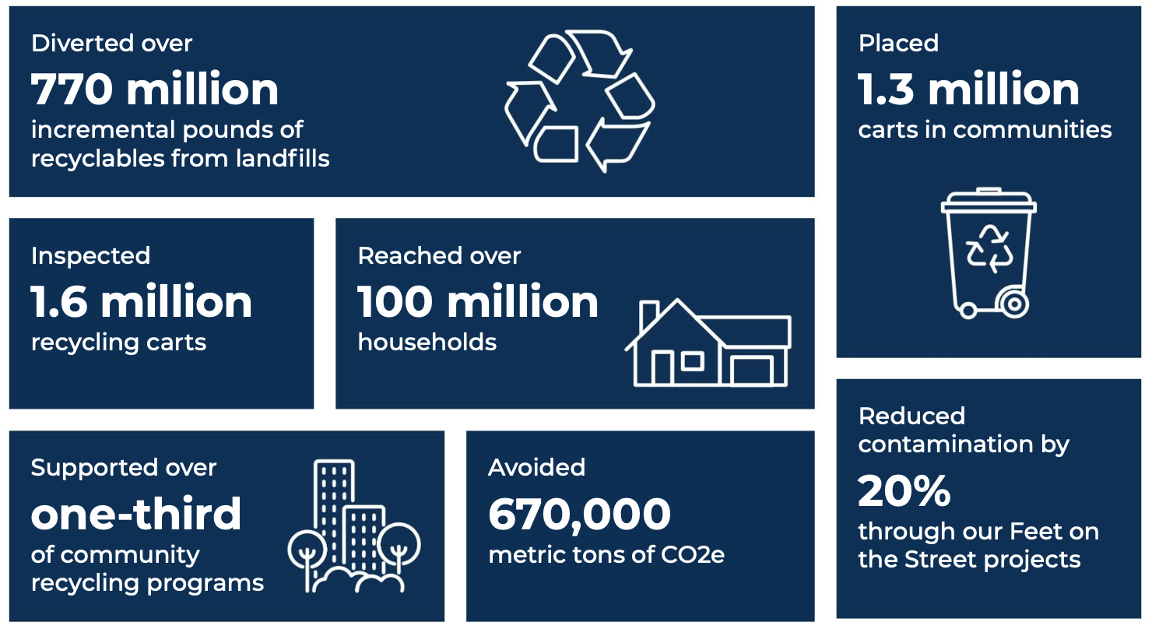
Circular System Benefits since 2014
Notes:
Our 2022 Impact Report was released last week.

Slide 7
Curbside Carts – our standard grant
Notes:
Ask anyone in the room if they are interested in pursuing carts in advance

Slide 8
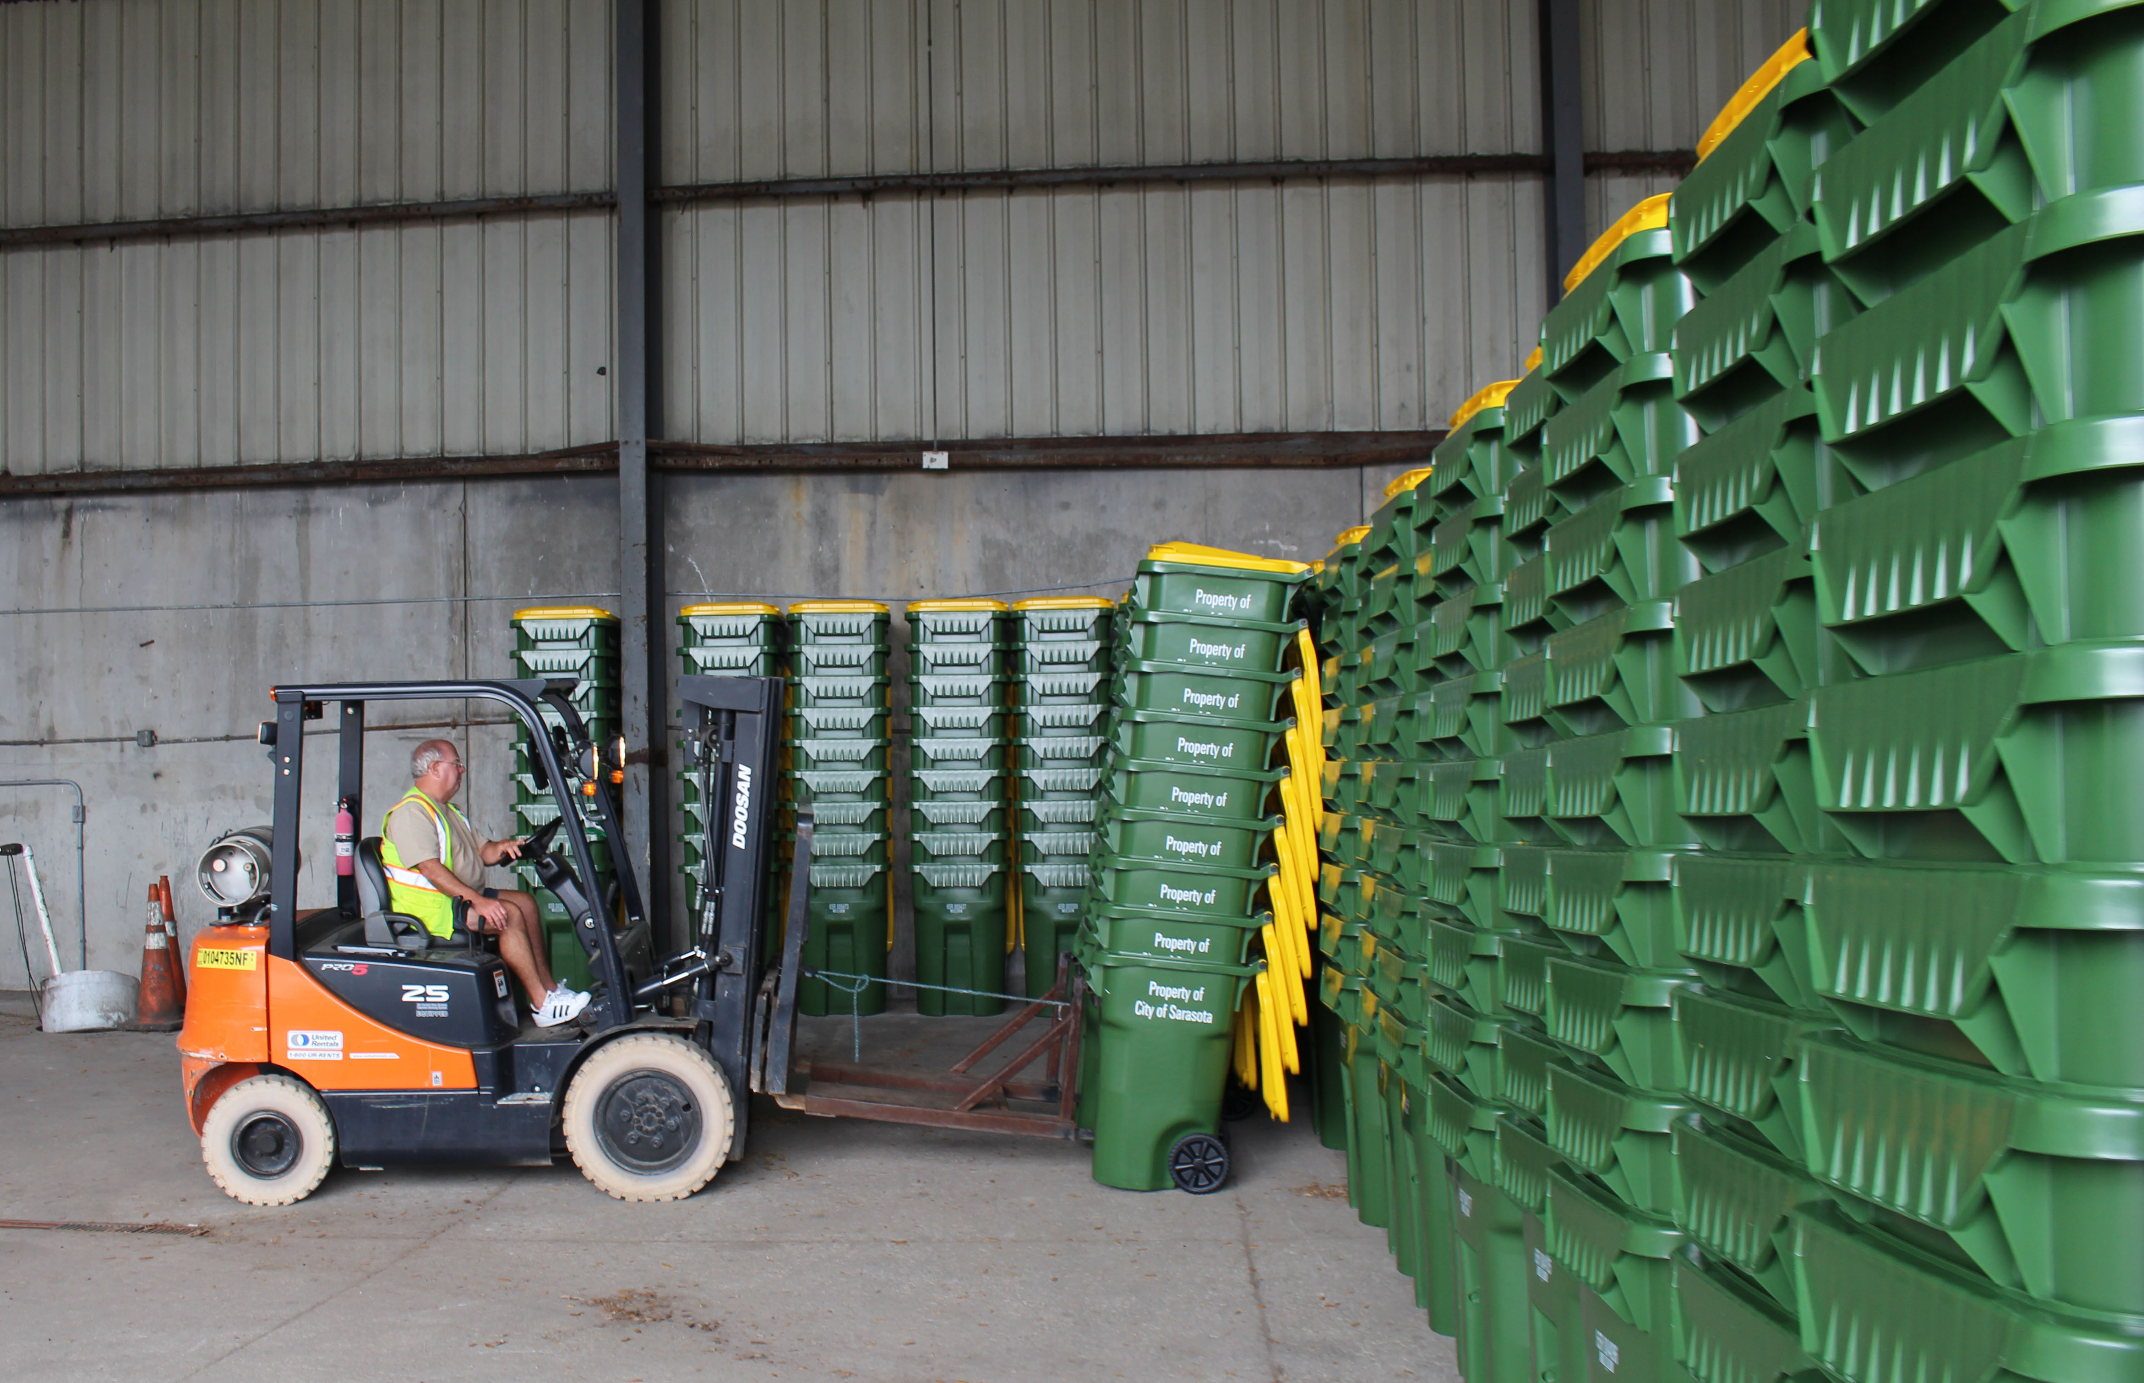
Recycling Partnership Residential Curbside Cart Grants
Grants for cart-based curbside recycling systems
Funding up to $15/cart, depending on service type
Technical assistance and design of education/ outreach materials
RFP available on an on-going basis
Designed to align with State grants
https://recyclingpartnership.org/recycling-cart-grant/

Slide 9
Recycling Partnership Residential Curbside Cart Grants
Application only takes a few hours
Can often award in just a few weeks
Happy to fund projects 18 months out
Can put money on the table before final OK from local gov.
Last a year after project implementation for data collection
https://recyclingpartnership.org/recycling-cart-grant/

Slide 10
Why Invest in Cart Based Recycling
Cart based collection is most efficient way to increase and sustain high recycling rates
Carts are the best way to respond to public demand for recycling service
Citizens see recycling as a clear sign of their community’s commitment to protecting the environment
Effective recycling is critical to meeting sustainability goals

Slide 11
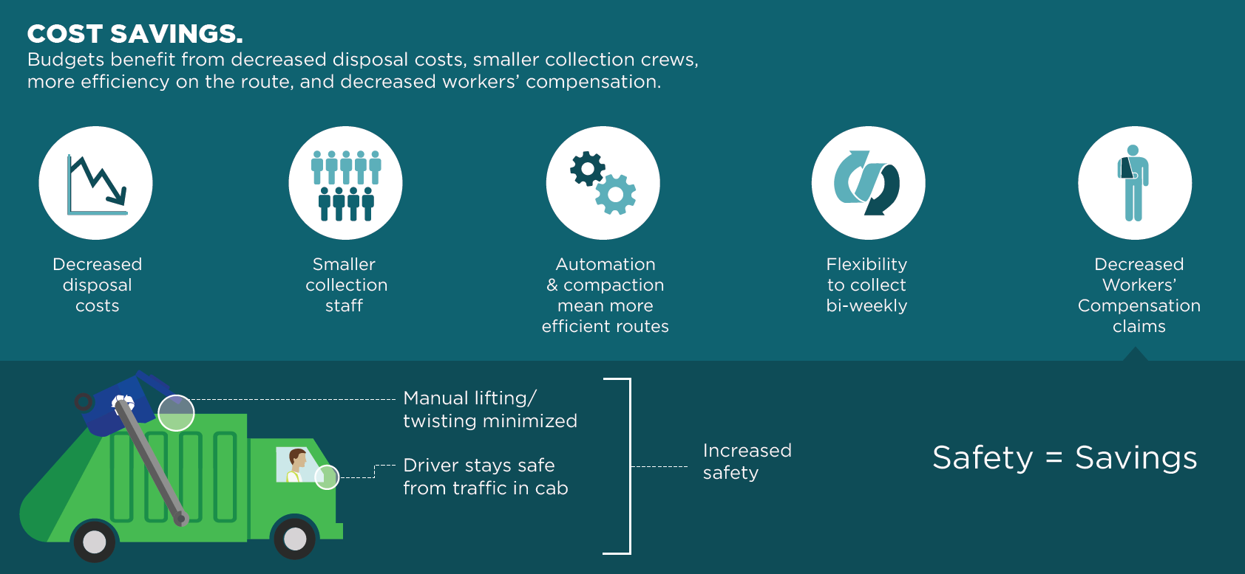
More Advantages of Carts

Slide 12
  2020 State of Curbside Report: Container Type
Data from 435 Curbside Programs across U.S.

Slide 13
Selling your curbside project to the Partnership
Tonnage
Access
Small Town / Rural
Regional Development / Cooperation
Wyoming / West

Slide 14
Drop Off – active development

Slide 15
Drop-off Recycling – teaser for tomorrow morning
Staffed Sites
Clear Signage
Comingled collection
Compaction
Optimized movement
Proximity to transfer station / MRF

Slide 16
What might we fund related to drop-off
Site Development
  Construction and planning
  Concrete Pads
  Grading work / electrical
Infrastructure
  Compactors preferred
  Roll-offs
  Bunkers
Hub and Spoke
  Soft shell Transfer Station
  Hard shell Transfer Station
  Transfer Station retrofit
Education
  Signage
  Mailers to promote recycling

Slide 17
Selling your drop-off project to the Partnership
Same as curbside PLUS
Pilot opportunities to spec future grants
Data – before and after
Capable partner

Slide 18





Lots more to think about – let’s take a breather
Notes:
Michigan – can actually cover full cost of carts
Other co-grants in NY, MA, NC, IN

Slide 19
Processors – Coalition led but growing

Slide 20
Beyond Residential Grants
Imagine a perfect residential recycling system
  Universal and equitable access
  Efficient and safe collections
  Right mix with no contamination

Slide 21
Beyond Residential Grants
Imagine a perfect residential recycling system
  Universal and equitable access
  Efficient and safe collections
  Right mix with no contamination
Material is still getting lost at the MRF

Slide 22
Polypropylene Recycling Grants
MRF grants to support investments in equipment that enables MRF acceptance and recycling of polypropylene
  Optical or robotic sortation equipment
  Conveyors, bunkers or other storage for materials
  Dock space or PP related facility investments
Maximum Grant = $500,000, with additional funding available for outreach
PP recycling grant proposals due quarterly
Learn more at https://recyclingpartnership.org/polypropylene-coalition/

Slide 23
PET Recycling Grants
Grants are available to upgrade MRFs and PET reclaimers to:
  Capture more PET bottles
  Increase sortation capabilities for PET non-bottle rigids
  Strengthen recycling opportunities for pigmented and/or opaque PET
Maximum Grant = $500,000, with additional funding available for outreach
PET recycling grant proposals due quarterly
Learn more at recyclingpartnership.org/pet-recycling-coalition/

Slide 24
Can Capture Grants for MRFs
MRF grants to support investments in equipment that increase the capture of aluminum cans
  Eddy current, optical or robotic sortation equipment
  Conveyors, bunkers or other storage for materials
Maximum Grant = $75,000
Two rounds of applications, first cycle focused on southeast, second cycle nation-wide (6 grants total)
Working to build funding to support more grant cycles so reach out if you know of opportunities!

Slide 25
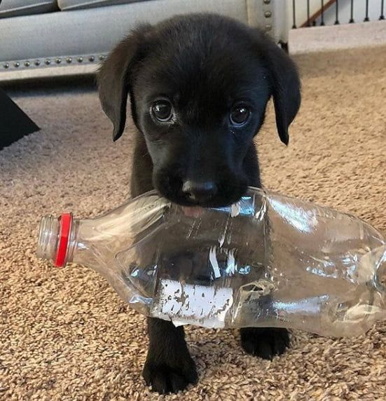


Just making sure you’re paying attention

Slide 26
State and Regional – massive leverage

Slide 27
MICHIGAN – The Partnership as Contractor
Phase I – SF & DO Quality Improvement
$2.1M contract 2020, extended 2021
14 grantees (representing over 100 communities)
DO Social Media Toolkit
DO Toolkit
Phase II – SF, MF & DO Quality Improvement
$1.3M contract for 2022
14 grantees (representing 98 communities)
App to Action grants
AI technology pilots (curbside, DO)
Small Community Education Grant
Phase III – Scoping for 2023

Slide 28
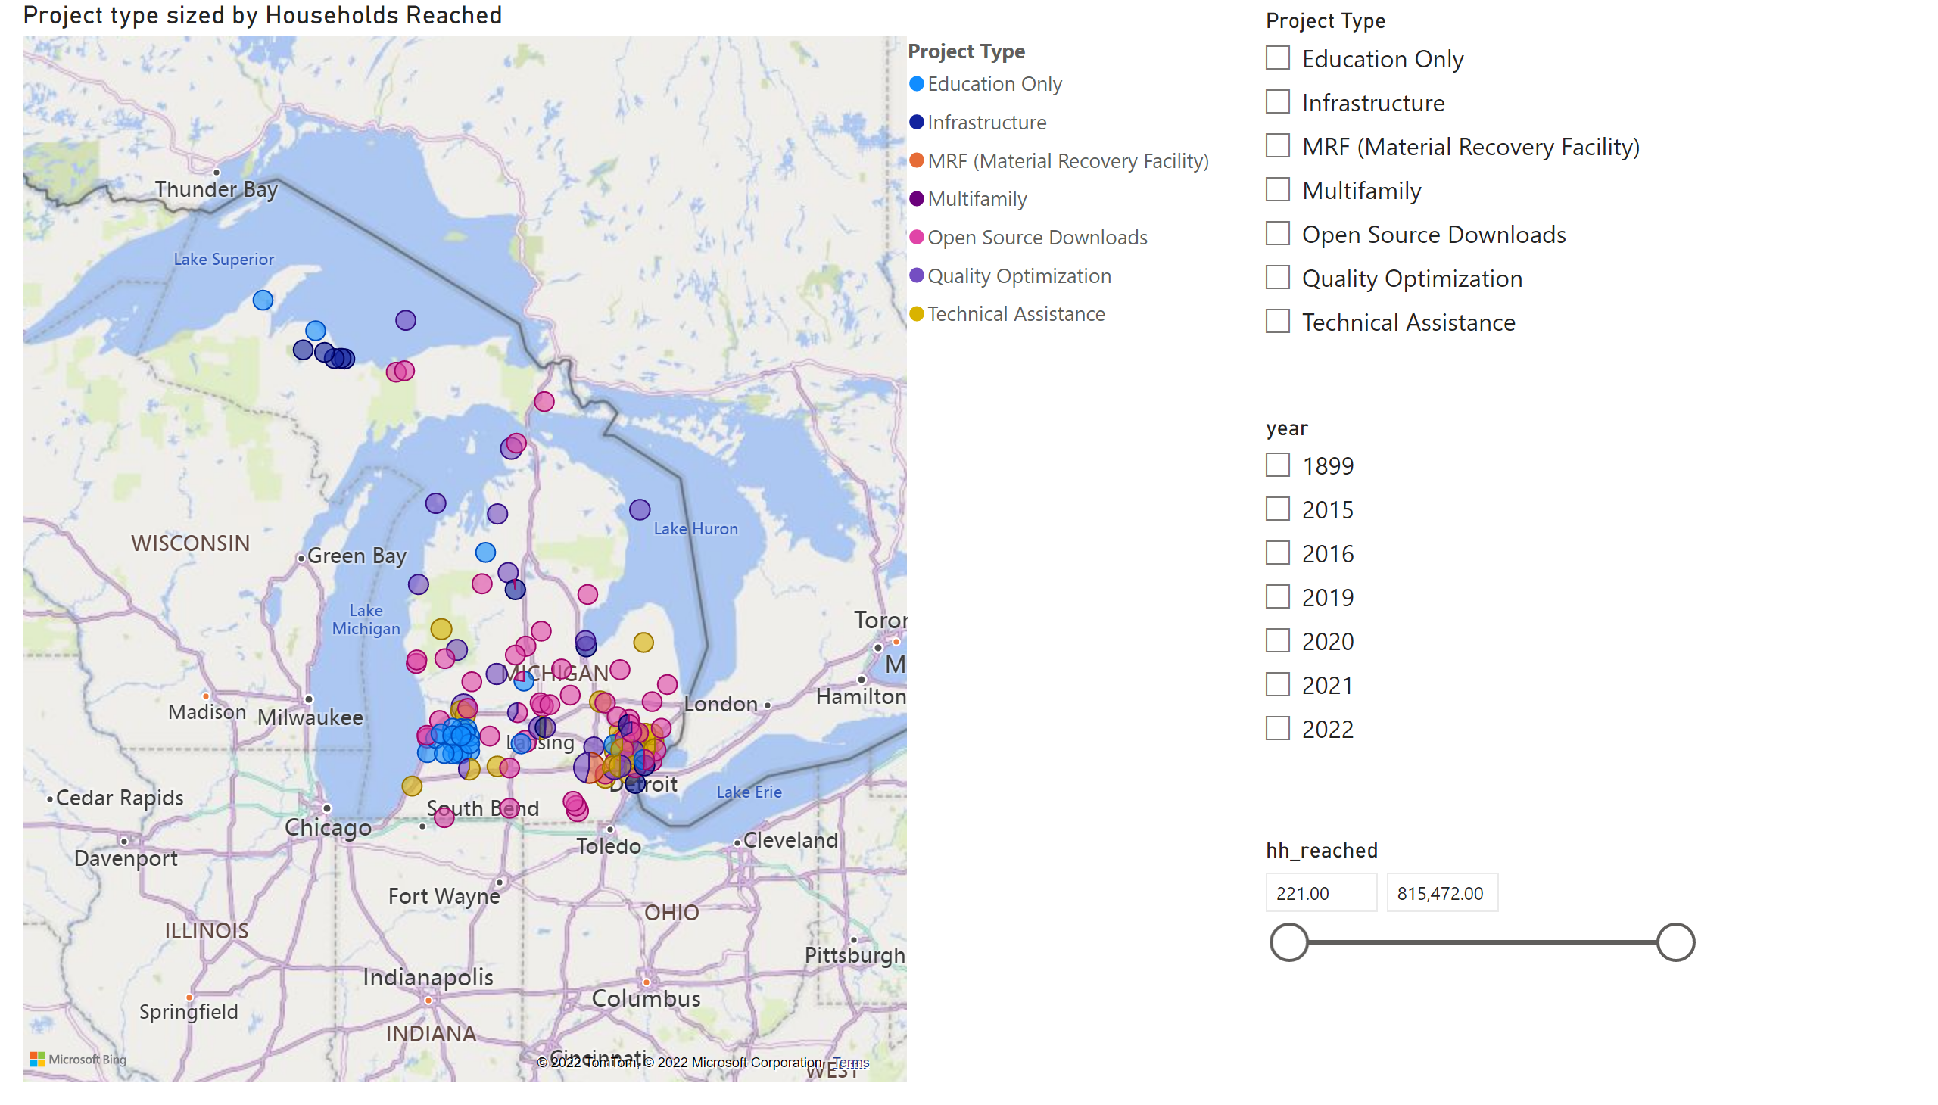
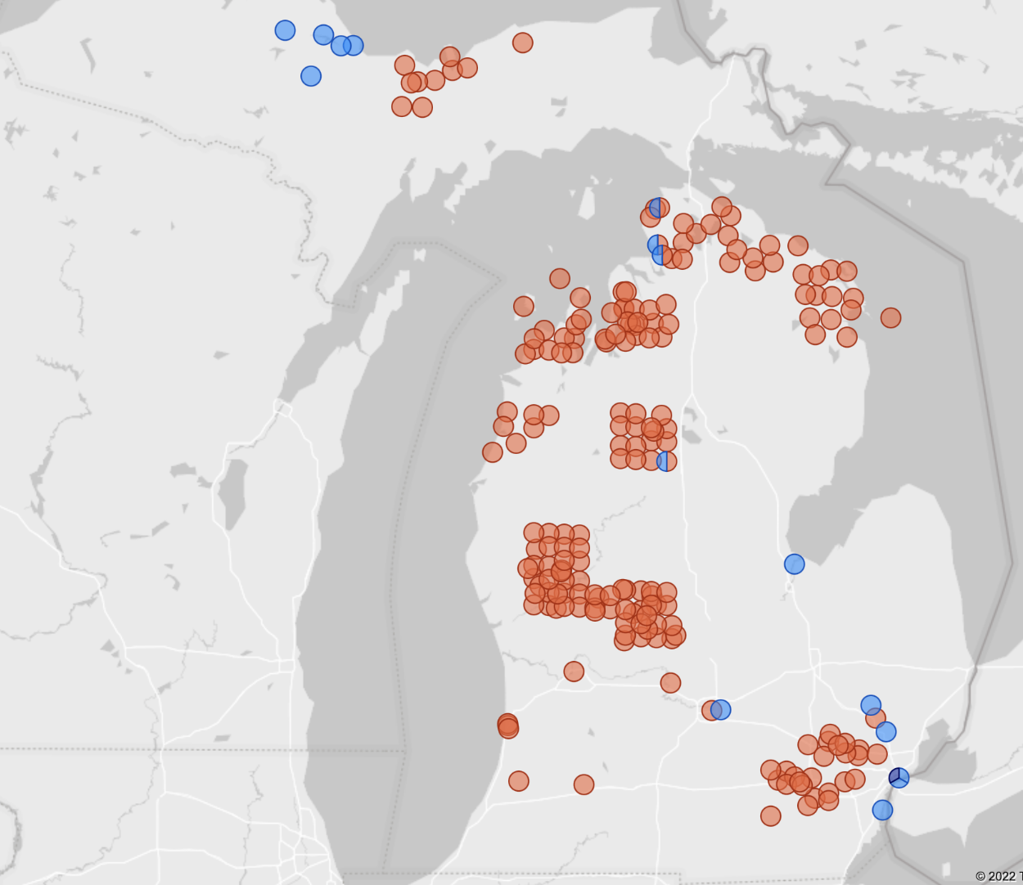
Michigan Scorecard
Impact in Michigan
Leveraged > $14M to date
Reaching 264 programs
>30K new tons unlocked annually
Prototyping new messaging tactics for scale
Curbside Infrastructure
Quality Improvement
MRF Infrastructure

Slide 29
OHIO – The Partnership as Grantee
Phase 1
2018 Special Assistance Grant
2-year project (ending Oct. 2020 extended Oct. 2021
$320,000 and $80,000 matching funds
4 MRF-sheds, 2-4 communities (representing 155,000 HHs)
Video & Customized toolkit
Goals
  Reduce contamination by 25-35%
    Communities are experiencing increase costs
    Communities are rethinking material mix and service levels
    More material going to landfill
    Contamination increases hazards to workers and MRF’s (batteries and needles)
  Engage and involve stakeholders
  Build roadmap for future granting initiatives

Slide 30
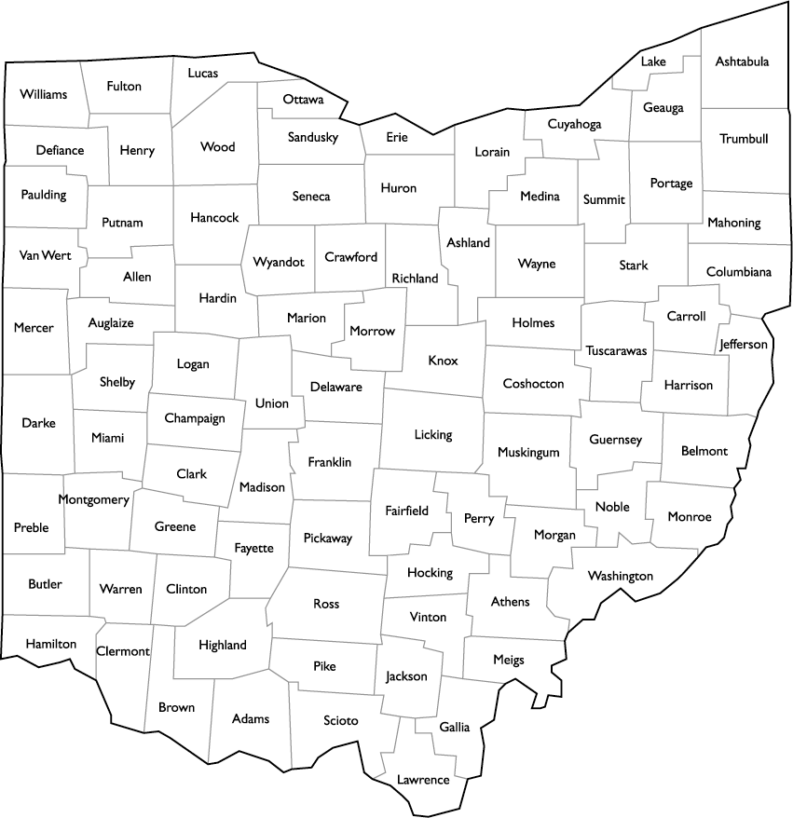
Program Map
Akron
33,000 X2
Republic
WM
Lorain
19,698
MRF:
Target-4 MRF-sheds
Hit-3 MRF-sheds
Communities
Target-4 communities totaling 155,000 hh
Hit-6 communities totaling 147,489
Kimble
Columbus
18,728
Rumpke
Centerville
2,028
Gahanna
10,216
Rumpke
Cincinnati
27,623 + 11,300
Colerain Township
17,400
New Richmond
920

Slide 31
Program Map
Community | HHs | Contamination
Phase 1 |  | Before | After | Reduction
Centerville | 2,028 | 19% | 11% | -42%
Fairfield | 11,594 | 22% | 12% | -45%
Columbus (varying sort methodologies) | 18,728 | 21% | 19% | -10%
Cincinnati | 27,623 | 28% | 20% | -29%
Akron | 33,000 | 39% | 28% | -28%
Subtotal | 92,973
Phase 2
Akron | 33,000 | 22% | 15%* | -32% (estimate)
Cincinnati | 11,300 | 26% | 21% | -19%
Gahanna | 10,216 | 22% | TBD | TBD
Subtotal | 54,516
MRF:
Target-4 MRF-sheds
Hit-3 MRF-sheds
Communities
Target-4 communities totaling 155,000 hh
Hit-6 communities totaling 147,489

Slide 32
NORTH CAROLINA – The Partnership as Grantor
NC DEQ has own granting initiative, infrastructure, staff
  Additional grant funds allow them to expand grant offerings
  Limited TRP technical assistance needed
  Use own (NC DEQ) previously developed collateral, press
  Scale effectively and efficiently
Not reimbursement grant– initial distribution (90%)
  all $ passed to communities
  all $ supports increasing recycling
Phase 1 - $100,000
  Waynesville (carts)
  Alleghany Co. (new DO program)
Phase 2 - $10,000
  Rose Hill & Princeton (carts)
Phase 3 - $250,000
  Multi-family
Notes:
NCDEQ and TRP’s goals are aligned and we both understood clearly our objectives making this a good partnership from the beginning. NCDEQ has strong experience and fully capability with capacity to carry out the goals and objectives of the project. NC has full administration of the grant so very light lift and little technical assistance needed from TRP side. 100% pass through of funds to the communities.

Slide 33
Making grants go further with co-granting
Michigan
  Can actually cover 100% of carts ; MI EGLE doesn’t cover E&O but we do
  Ad-hoc but close program collaboration
New York
  We covered truck costs due NY doesn’t allow two grants to cover same line item
Massachusetts
  Pairing with their PAYT planning and infrastructure grants
North Carolina
  Ad-hoc but close program collaboration
Notes:
Michigan – can actually cover full cost of carts
Other co-grants in NY, MA, NC, IN

Slide 34
Rural Community Allies
USDA
Councils of Government / Regional Organizations
Rural Community Assistance Program (RCAP)
Colleges/Universities
Notes:
Michigan – can actually cover full cost of carts
Other co-grants in NY, MA, NC, IN

Slide 35
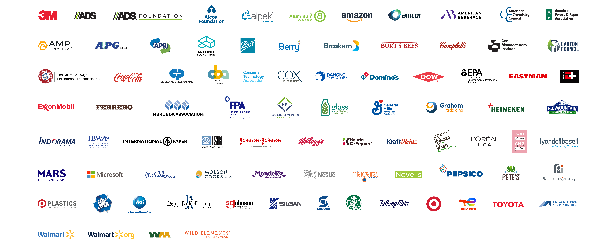
Thank you!

Slide 36

QUESTIONS?
Vincent Leray
he/him
Grant Development Manager
vleray@recyclingpartnership.org
662.640.8571

